Slide 1
TOPIC B3:
OBJECT ORIENTED PROGRAMMING
LESSON B3-7
ABSTRACTION, COMPOSITION, & AGGREGATION

Slide 2

AGENDA
Abstract Classes
Programming Abstract Classes
Composition
Aggregation
Relationships in UML
WHAT U NEED 4 LESSON
Pycharm
Notes Document

Slide 3

THE WARM UP QUESTION
Give an example of a scenario where you should use inheritance to create two child classes from one parent class

Slide 4
THE WARM UP ANSWER
Example: Plants, Monocots, Dicots

Slide 5

ABSTRACT CLASSES
Last time, we discussed inheritance and polymorphism
We have parent classes that child classes can inherit variables and functions from
Today, we’ll be talking about abstract classes

Slide 6
ABSTRACT CLASSES
Abstract classes – classes that are generic templates without any executable code of their own
Abstract classes cannot be instantiated
There cannot be objects of an abstract class
Abstract classes are designed to be parent classes for non-abstract child classes

Slide 7
ABSTRACT CLASSES
Abstract classes are used when you know all children will have certain functions – but those functions will act differently in each child
In this case, it wouldn’t make sense for the parent class to have that function
But, because we know that all children will have it, we can use an abstract class as a template to ensure that all children have it

Slide 8
ABSTRACT CLASSES
Abstract classes do not provide any functions
They provide standardization and consistency when creating child classes
If somebody comes along to implement a new child class, they know what functions they must implement
If a developer tries to use a class in their program, they will know all children of a class will have those functions

Slide 9
ABSTRACT CLASSES
Example: let’s say we have an app that manages various 2D shapes
All different 2D shape objects should have what functions?

Slide 10
ABSTRACT CLASSES
Example: let’s say we have an app that manages various 2D shapes
All different 2D shape objects should have what functions?
Area
Perimeter

Slide 11
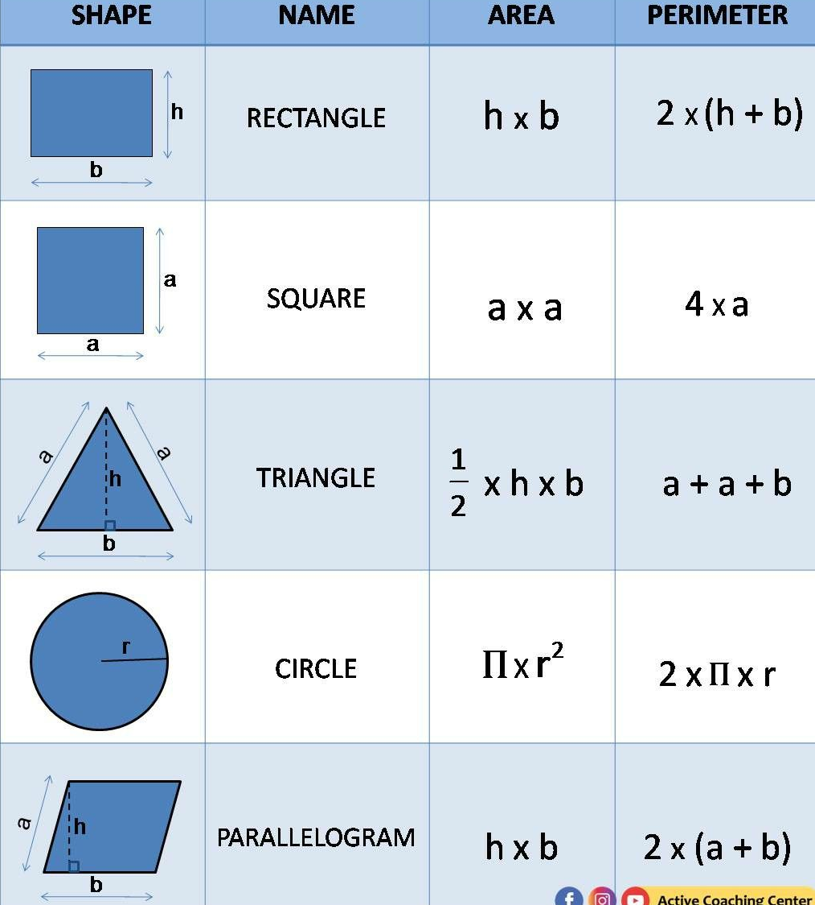
ABSTRACT CLASSES
Circles, triangles, and rectangles all have different formulas to calculate area and perimeter
But, you can’t calculate the area or perimeter for a vague ‘shape’ class, as that just doesn’t make sense

Slide 12
ABSTRACT CLASSES
So, our abstract class will have abstract functions for getArea and getPerimeter that will be programmed separately for each
This means that if we have, say, a list of 2D shapes, we can call the same function

Slide 13
PROGRAMMING ABSTRACT CLASSES
To implement an abstract class in Python, we have to do a few things:
Import ABC (abstract base class)
This is what all of our abstract classes will inherit from
Because we’re doing our 2D shapes, I’m also importing math to get pi
from abc import ABC, abstractmethod import math

Slide 14
PROGRAMMING ABSTRACT CLASSES
Abstract shape class declaration
Inherits from ABC
All functions are declared with @abstractmethod
All function bodies only say ‘pass’, meaning they don’t do anything
class Shape(ABC): @abstractmethod def get_area(self): pass @abstractmethod def get_perimeter(self): pass

Slide 15
PROGRAMMING ABSTRACT CLASSES
Now, for the classes that inherit from Shape
First, rectangle
Rectangle’s parent is the Shape abstract class
We still need the constructor
We have get_area and get_perimeter functions, like the abstract parent class does, except they actually do something
class Rectangle(Shape): def __init__(self, width, height): self.width = width self.height = height def get_area(self): return self.width * self.height def get_perimeter(self): return 2 * (self.width + self.height)

Slide 16
PROGRAMMING ABSTRACT CLASSES
Next, let’s do circle
Circle’s parent is also the Shape abstract class
We still need the constructor
We have get_area and get_perimeter functions, like the abstract parent class does, except they actually do something
But, they act different than rectangle’s
class Circle(Shape): def __init__(self, radius): self.radius = radius def get_area(self): return math.pi * self.radius ** 2 def get_perimeter(self): return 2 * math.pi * self.radius

Slide 17
PROGRAMMING ABSTRACT CLASSES
math.pi (from the math library) is used here as a stand-in for Pi
class Circle(Shape): def __init__(self, radius): self.radius = radius def get_area(self): return math.pi * self.radius ** 2 def get_perimeter(self): return 2 * math.pi * self.radius

Slide 18
PROGRAMMING ABSTRACT CLASSES
Finally, let’s write some code to test this out
This is a list of shapes, both circles and rectangles
They are being put directly into a list, like you could do with integers
shapes = [ Rectangle(10, 4), Rectangle(36, 7), Circle(42), Circle(5) ]

Slide 19
PROGRAMMING ABSTRACT CLASSES
Then, I’m going to loop on that list to print out all of those shapes’ areas and perimeters
Even though the area and perimeter functions are different, we can safely do this because of the abstract class!
for i in range(len(shapes)): print(shapes[i].get_area()) print(shapes[i].get_perimeter())

Slide 20
PROGRAMMING ABSTRACT CLASSES
Use case reminder:
Not every parent class should be abstract
Abstract classes are used ONLY when the parent class should NOT be instantiated
Make sure that ALL functions in an abstract class are implemented in ALL children
for i in range(len(shapes)): print(shapes[i].get_area()) print(shapes[i].get_perimeter())

Slide 21

COMPOSITION
Switching gears:
Classes are analogous to data types
Objects are analogous to what?

Slide 22
COMPOSITION
We can often have programs where
One class has objects as variables inside of it
This process can repeat into multiple levels of depth
In these instances, objects are related to each other and dependent on each other

Slide 23
COMPOSITION
There are multiple types of relationships
Inheritance is a type of relationship, because a child class requires the existence of a parent class
We call this an ‘is a’ relationship
A rectangle is a shape
A circle is a shape

Slide 24
COMPOSITION
Composition – where one object is composed of one or more objects
A strong ‘one is part of another’ relationship
The composed objects cannot exist without the containing object
Sometimes called a ‘death’ relationship, because if the whole is destroyed, so are its parts

Slide 25

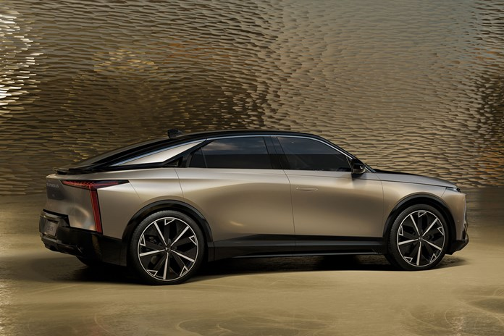
COMPOSITION
Examples of composition:
Car and Engine: Car object is composed of an engine object
Engine is essential to car function
Outside of the car, doesn’t serve the purpose it was designed for
Car destroyed = engine destroyed

Slide 26


COMPOSITION
House and room:
House object composed of multiple room objects
Rooms are a part of a house
If the house is demolished, rooms cease to exist

Slide 27
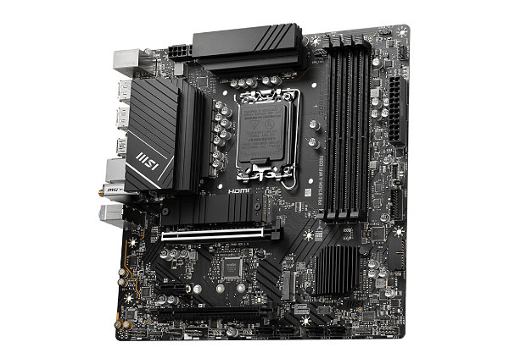
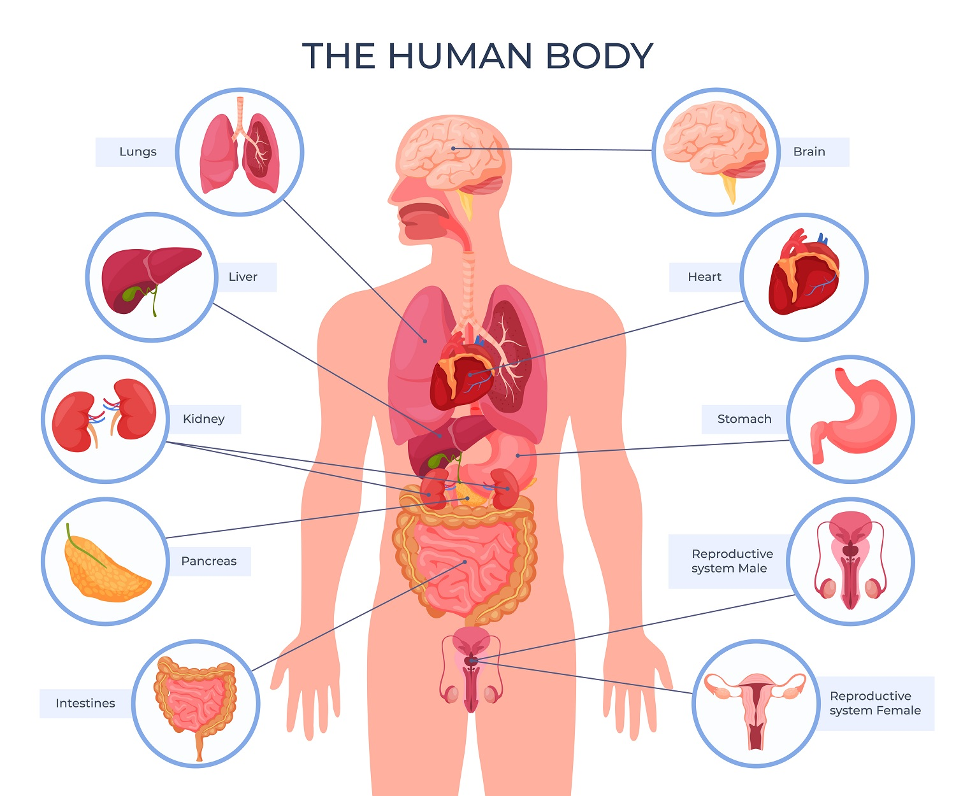
COMPOSITION
Computer and Components:
Computer object composed of CPU, Motherboard, Memory, etc.
Components do not function individually if separated
Human and organs:
Human object composed of a Heart, Brain, and Lungs
Organs are essential for body, but don’t function outside of it

Slide 28
COMPOSITION
What’s another example of composition? Jot it down in your notes.

Slide 29
AGGREGATION
Aggregation – one object contains another, but that contained object can exist independently without the container
If the container ceases to exist, the previously contained objects can still exist in their own way

Slide 30

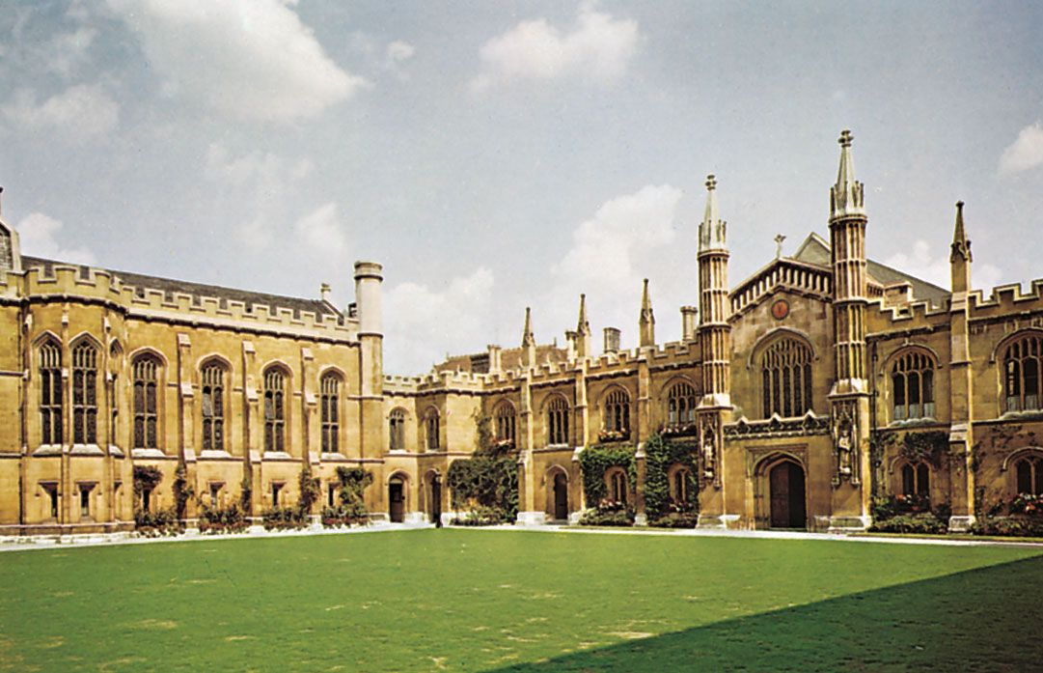
AGGREGATION
Aggregation example:
University and Student:
University object contains many student objects
If the university was to close, or a student graduates, the student continues to exist without being attached to the university

Slide 31

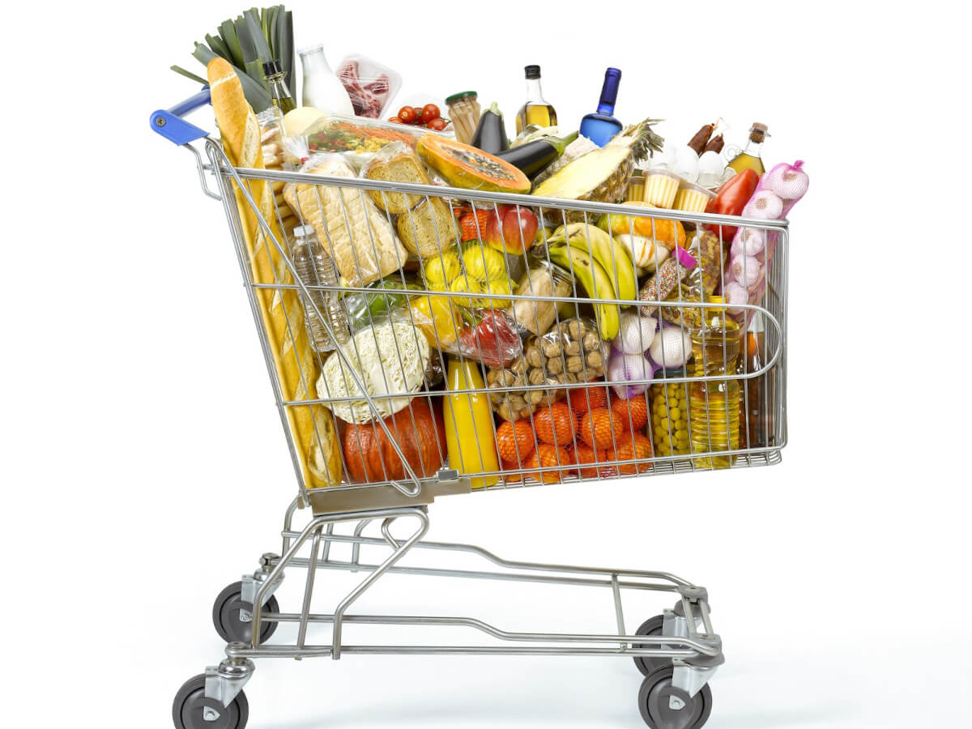
AGGREGATION
Library and Books:
A library contains many book objects, but the books can exist outside the library
Shopping Cart and Produce
A shopping cart contains many Produce objects, but they aren’t dependent on the car for existence

Slide 32

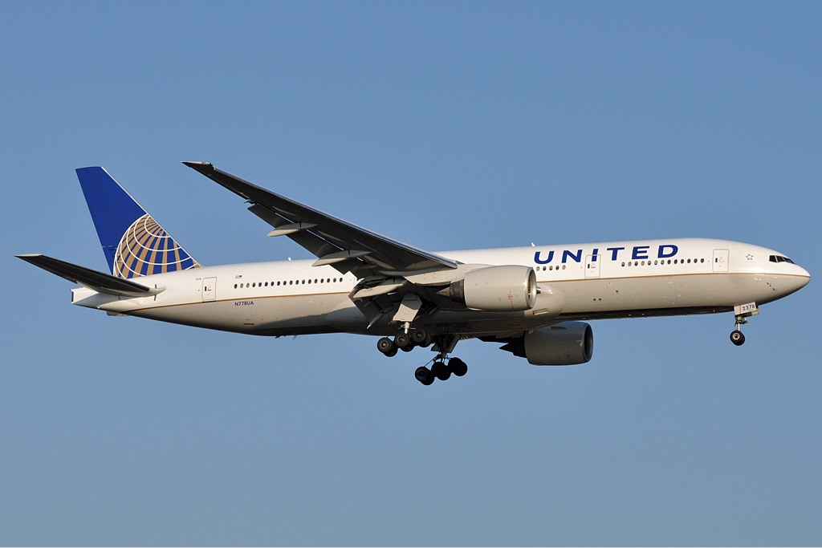
AGGREGATION
Computer and Peripherals:
A computer system can have references to Keyboard, Monitor, Mouse, etc
Those peripherals can still be used with other computer systems
Airline and Airplanes:
Airline has a fleet of airplane objects, but they can be sold or transferred to other airlines

Slide 33
AGGREGATION
What’s another example of aggregation?

Slide 34
AGGREGATION
The distinction between aggregation and composition can be arbitrary and debated
In a mechanic’s garage, a car’s engine might be aggregation instead of composition, since it has a function outside of one car
The key here is to demonstrate your understanding of context of the scenario at hand

Slide 35
AGGREGATION
Both aggregation and composition are ‘has a’ relationships
Remember that polymorphic relationships are called what?

Slide 36
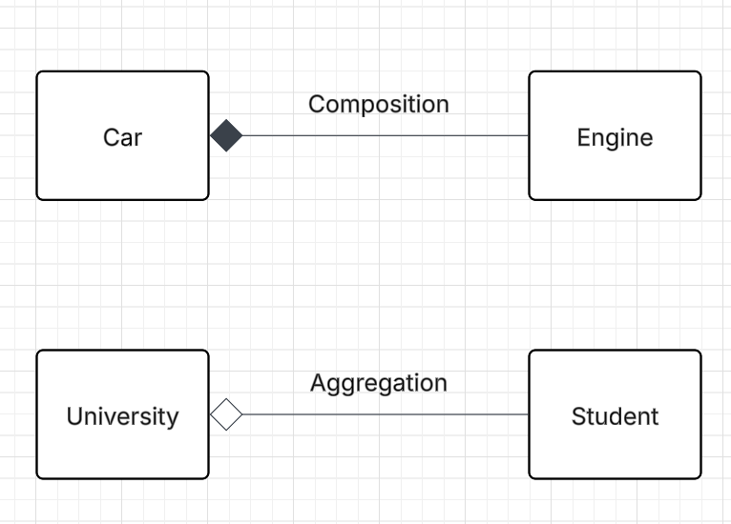
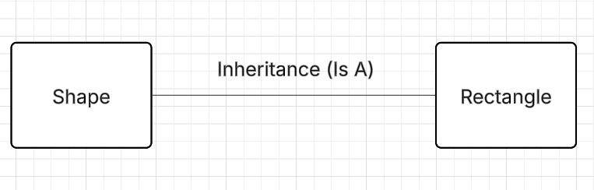
RELATIONSHIPS IN UML
Has a relationships in UML
Note the distinction between
Full Diamond: Composition
Empty Diamond: Aggregation
The boxes can be represented by full UML tables, this is just for demonstration

Slide 37
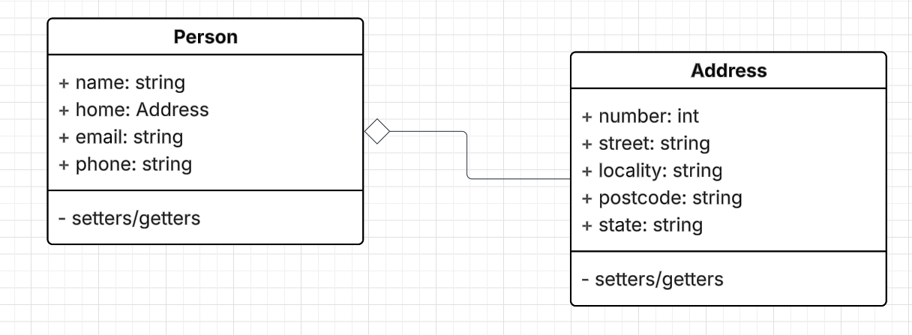
RELATIONSHIPS IN UML
Consider the following scenario, where a Person object has an Address object as an instance variable
Should this be an example of aggregation or composition?
Answer in your notes

Slide 38
LABBB
Implement the Triangle class into your program from earlier, inheriting from shape, and with functions for perimeter and area.

Slide 39
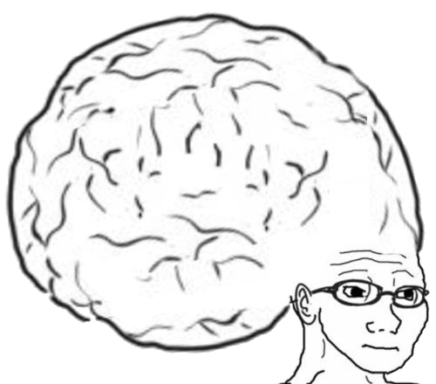
VOCABULARY TO REMEMBER
Abstract Class
Abstract Function
Composition
Aggregation

